Slide 1
VENDOR ROUTING GUIDE
Updated Feb 1st, 2024
V7 PRIVATE LABEL

Slide 2

Table of Contents
Introduction
Pallet Requirements & Guidelines
Booking
Air
Ocean
Compliance
C-TPAT
Ingram V7 Branches & Contacts
ISF
Shipping Documents

Slide 3

Introduction
Ingram Micro is committed to provide its customers the highest possible customer service.
Please read this guide before shipping Ingram Micro Purchase Orders to ensure that you adhere to the guidelines and avoid any future possible charge back violations and/or financial penalties.
These requirements are structured to provide supply chain efficiencies that support our needs and those of our customers

Slide 4
Pallet Requirements
Pallets Specifications
Requirements and Guidelines
Violations

Slide 5
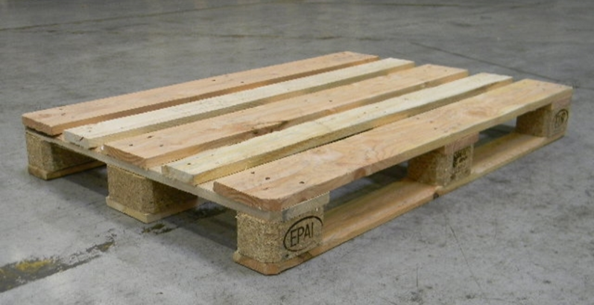
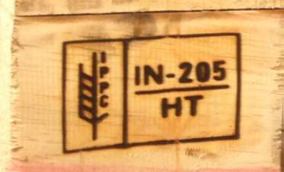
Pallet Specifications
Pallet Entry
Heat Treated
Pallets must have a 4-way entry to enable easy handing for forklift
Wood pallets used for exports must be heat treated according to ISPM15
Heat treated WPM can prevent the inconvenience & cost of quarantine at destination port
Treated product must be marked with this symbol:

Slide 6
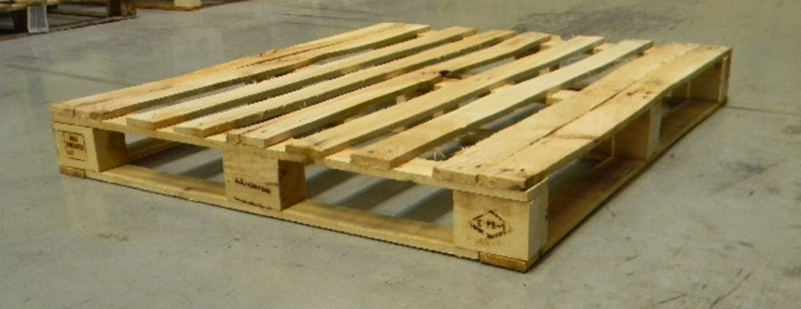
PALLET REQUIREMENTS
Industrial Wood Pallet
Dimension = preferred 1200mm x 1000mm or 48” x 40”
Max Stacking Height = preferred 2000mm or max 2300mm
Max Load Capacity = 1500 kg
Bottom runners required for long side (at minimum)

Slide 7


Industrial-pallet 1.00m * 1.20m
Bottom runners on the short and the long side of the pallet
=> it‘s stable

Slide 8

One way pallet (Industrial size) 1.00m * 1.20m
Important:
The pallet must always have a bottom runner on the long side (1.20m)
If the bottom runner is only on the short side (1.00m) it is a wrong pallet type

Slide 9
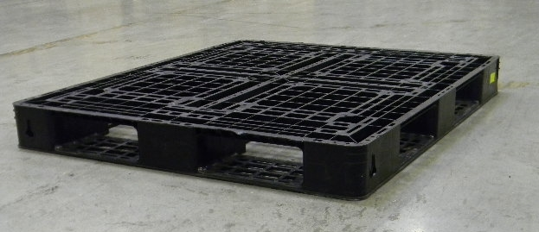
Plastic pallet (industrial size 1.00m * 1.20m)
Only this construction of a plastic pallet is allowed.
Bottom runner around the whole pallet. Bottom runner must be connected with every block => stability
(not allowed versions of plastic pallets see next slide)

Slide 10


Plastic-pallet
This construction of a plastic pallet is not allowed.
Problem: stability
=> has no bottom runner

Slide 11
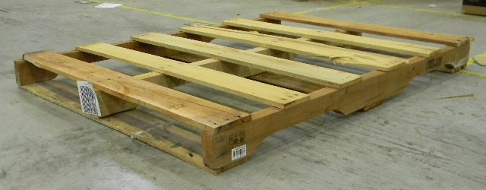
Wrong Pallet type
American pallet type (48 inch x 40 inch)
Although this pallet-type has the right size it‘s not usable because of the construction (not the same like an Euro-pallet)
Problems:
No bottom runner on the long side of the pallet
Too small access openings on the long side of the pallet
Pallet-type doesn‘t fit with the picking modul and pallet conveyer

Slide 12
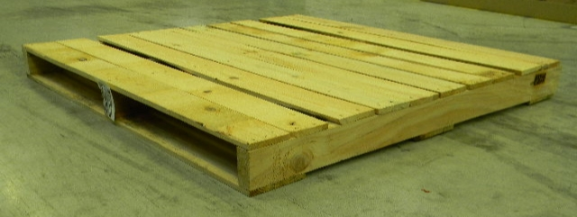
Wrong Pallet type
American pallet type (48 inch x 40 inch)
Although this pallet-type has the right size it‘s not usable because of the construction (not the same like an Euro-pallet)
Problems:
No bottom runner on the long side of the pallet
No access openings on the long side of the pallet
Pallet-type doesn‘t fit with the picking modul and pallet conveyer
They get damaged

Slide 13
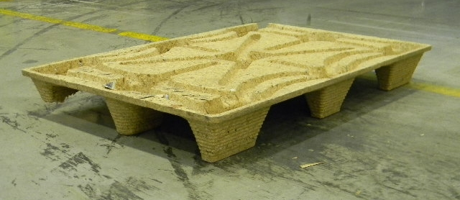
Wrong Pallet type
,,pressboard-pallet‘‘
Problems:
No bottom runners
stability
Pallet-type doesn‘t fit with the picking modul, the racks and the pallet conveyer
Wrong material

Slide 14
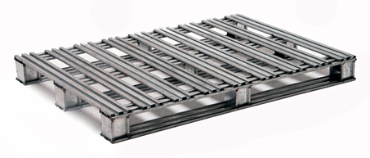
Metal-pallet
Not allowed:

Slide 15
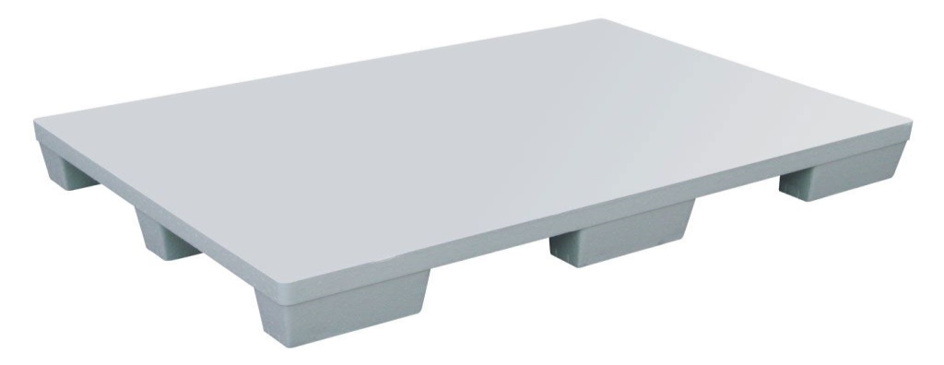
Styrofoam-pallet
Problems:
No bottom runners
stability
Pallet-type doesn‘t fit with the picking modul, the racks and the pallet conveyer
Wrong material

Slide 16


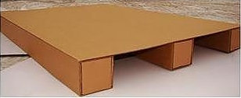
Carton-pallets
Problems:
No bottom runners
stability
Pallet-type doesn‘t fit with the picking modul, the racks and the pallet conveyer
Wrong material

Slide 17
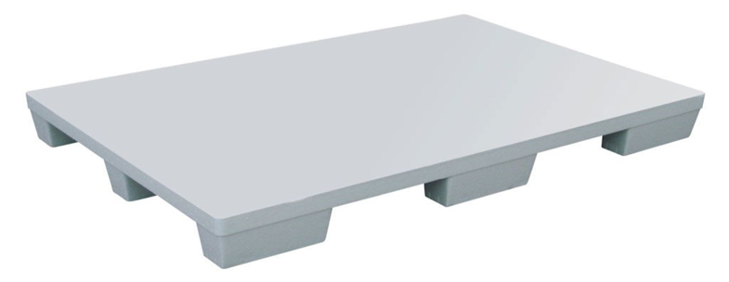

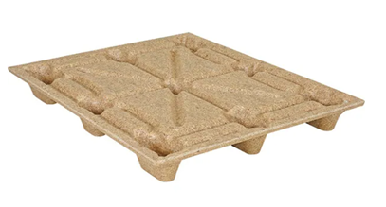
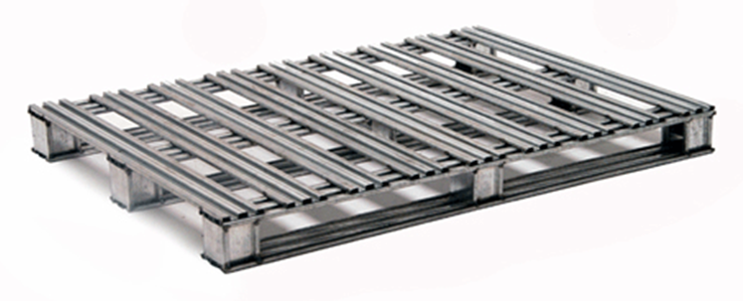

Wrong Pallets – DO NOT USE
Styrofoam pallet
Pressboard pallet
Missing bottom runners
Metal pallet
Cardboard pallet

Slide 18

Steps to Build a Pallet

Slide 19
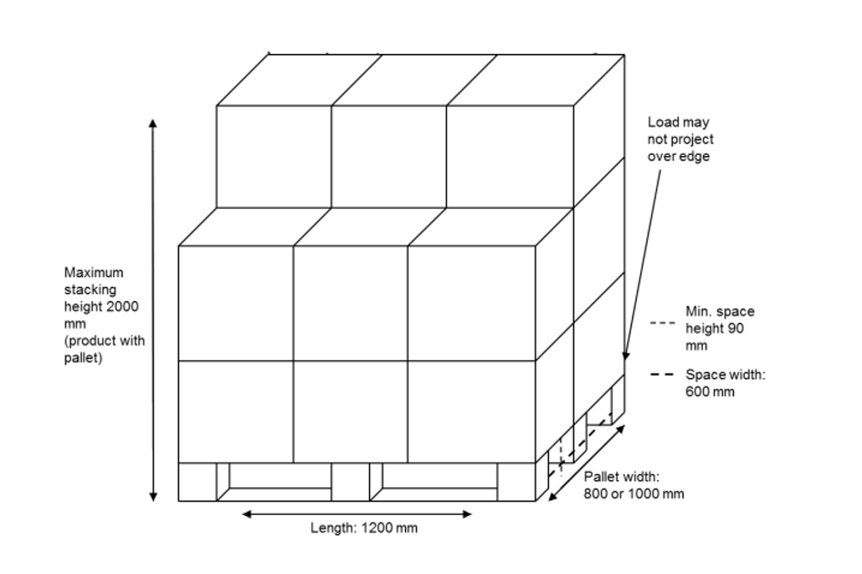
Pallet Illustration
Dimension & Construction

Slide 20


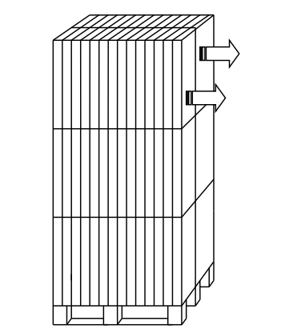

Stacking and Sorting
    Acceptable Stacking
    Cartons are placed in longitude & lateral positions for stability
    Goods can be removed without collapsing
    NOT Acceptable Stacking
    Boxes stacked facing same direction
    Pallet can easily tip over

Slide 21

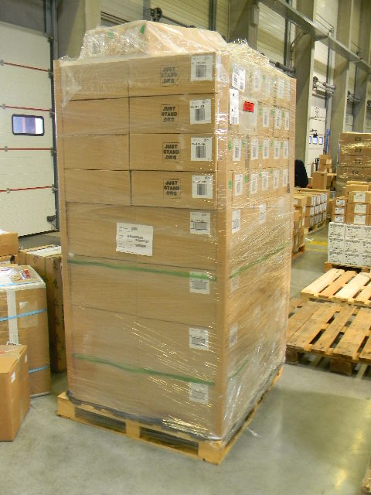
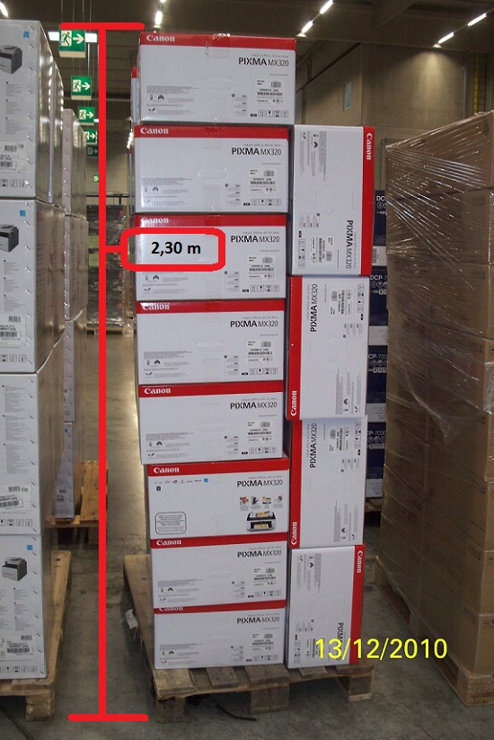
Pallet height
Maximum pallet height is 2m (includes pallet & cartons)

Slide 22
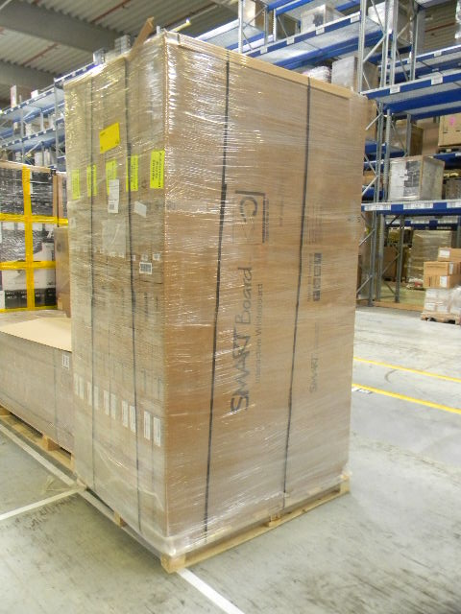
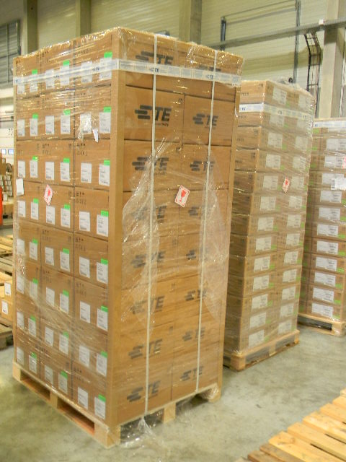
Pallet height & size - EXCEPTION
1.40m
Safety of the product is priority
0.28m
0.44m
0.60m
2.34m
2.30m
1.00m
1.40m
1.32m
1.20m
Dimensions of the single product are bigger than
1.20m (size) to 2 m (height)
Dimensions of the single product are smaller than
1.20m (size) to 2 m (height)

Slide 23

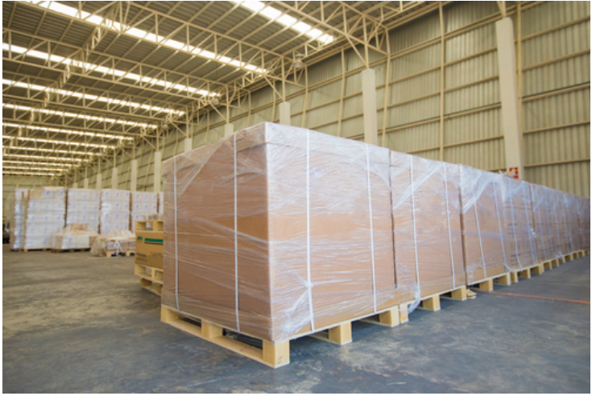
Shrink Wrap & Boards
Use Shrink Wrap Liberally
  Wrap entire pallet 3 to 5 times
Use corner boards for stabilization

Slide 24
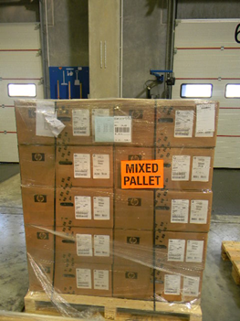
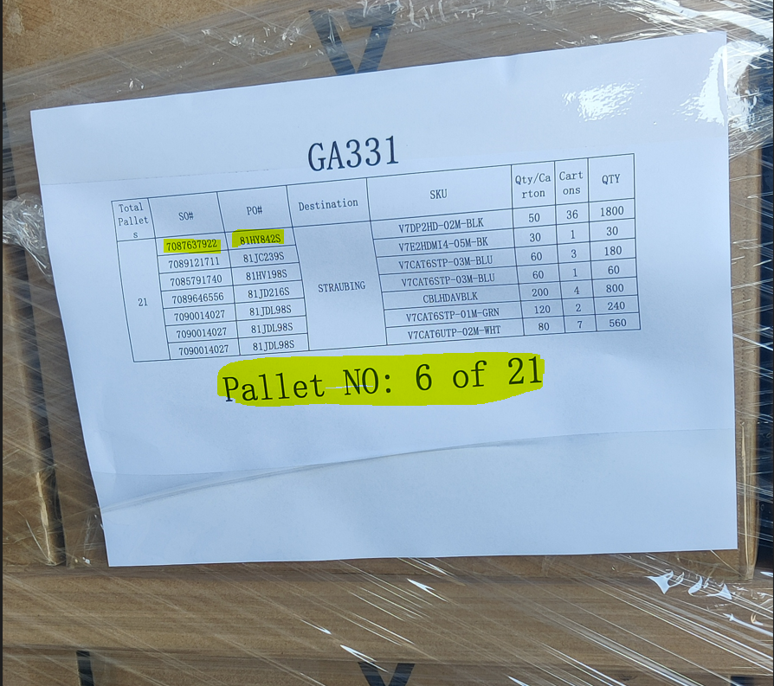
Labeling of the Goods on Pallets
Shipping label requirements:
Ingram Micro’s PO number (7000xxx)& Reference # (81-xxxx)
Sequential # of the pallet & total number (e.g., pallet 3 of 5)
Number of units per pallet
Attach outside shrink wrap
Must be visible from the outside
Must have labels on each opposite side
Mixed pallet must be identified with the relevant packing slip

Slide 25
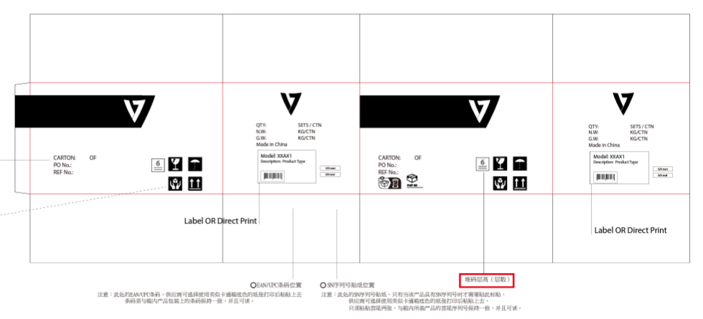
Master Carton Label Requirements
    MAIN PANEL
    PO#
    Reference #
  SIDE PANEL
  Model no.
  Quantity
  Net Weight
  Gross weight
  EAN /UPC Code
  Country of Origin: Made in XXXX
  Serial # - Start # and End # (only if applicable)

Slide 26
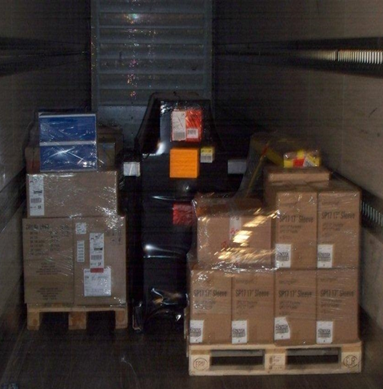
Loading Guidelines
Heavier packages go on the bottom, and lighter ones go on top
Make sure cargo is evenly distributed over the container’s floor area
Cover entire maximum area;
leaving no empty space
Floor load acceptable
(requires APPROVAL )

Slide 27
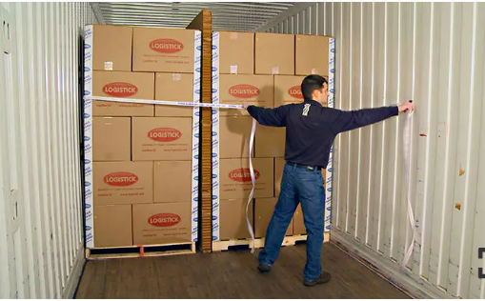
Strapping
Holds boxes in place, providing stability & protection for the products

Slide 28
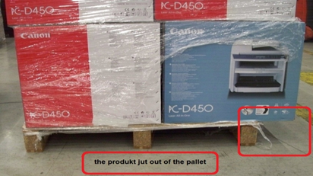
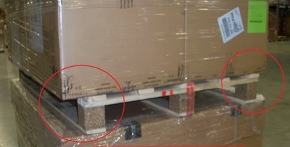
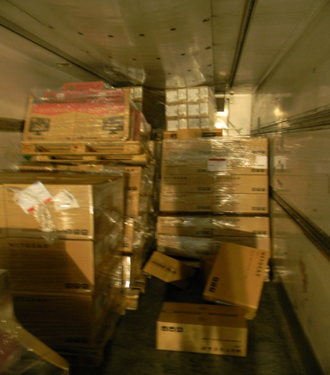
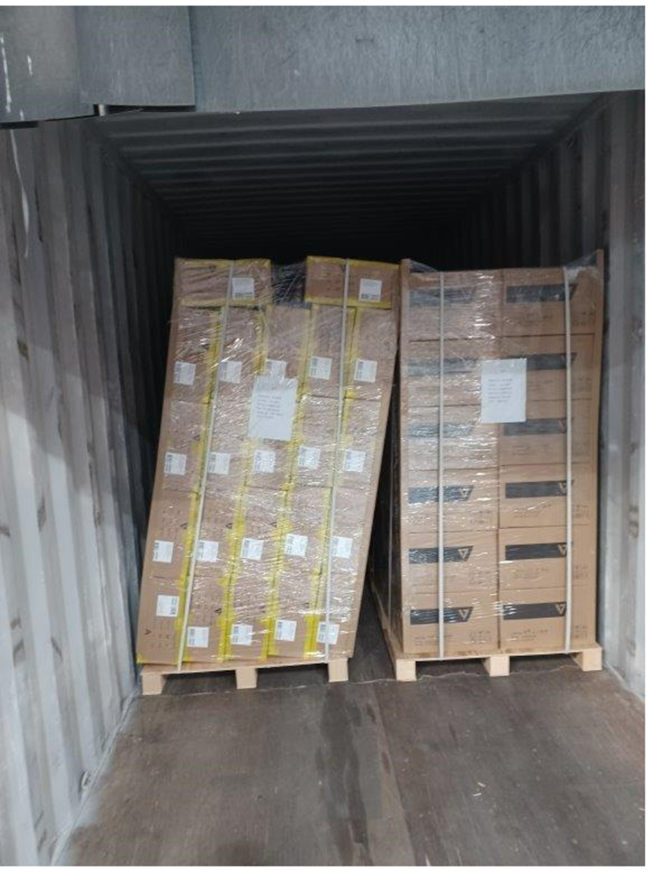
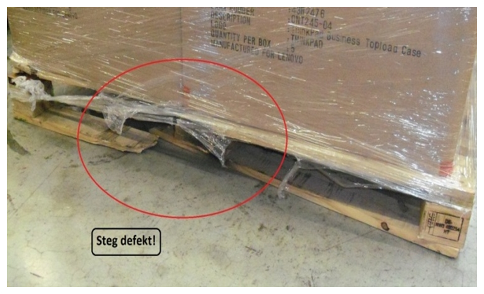
VIOLATIONS
Overhang
Defective pallet
Unstable

Slide 29



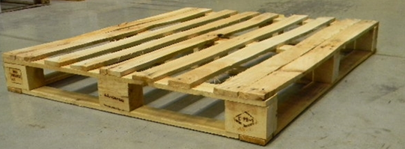


VIOLATIONS
NO
YES
No bottom runners
Bottom runner on all sides
Bottom runner on short-side only
Bottom runner on long-side only

Slide 30



Ocean & Heavyweight Air
Booking & Documentation Requirements

Slide 31
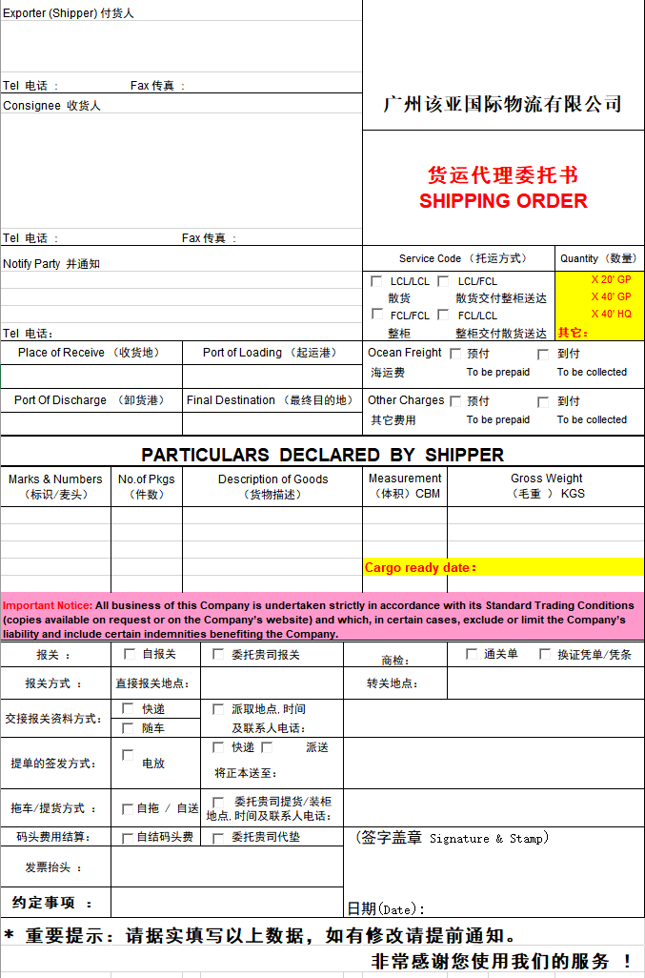
Carrier Booking Form OR Shipper’s Letter of Instructions
This document instructs the freight forwarder on how to ship cargo
It provides accurate shipper & consignee information
  Purchase Order No.
  Freight terms
And other special instructions
  Such as NOTIFY Party

Slide 32
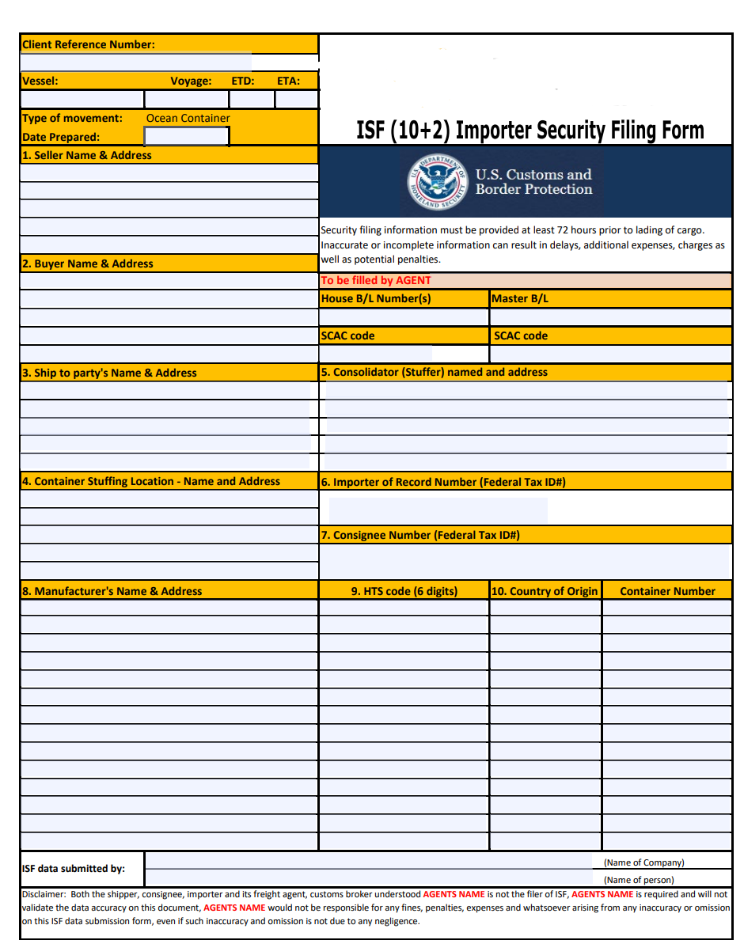
IMPORTER’S SECURITY FILING – FOR US OCEAN MODE ONLY
- US Customs filing requirement that documents importing information and details, as shipments pass from point to point
Importers who do not file the ISF properly prior to the shipment of their goods will be penalized (US$5,000 fine)
Carrier or freight forwarder will provide similar form (see below)
Vendor must return completed form to the freight forwarder 5 days (at minimum) prior to sailing of the shipment
Required Importer Data Elements
  Seller
  Buyer
  Importer IRS# (same as EIN#)
  Consignee IRS# (same as EIN#)
  Manufacturer (or Supplier)
  Ship to Party
  Country of origin
  HTSUS
  Container Stuffing Location
  Consolidator
  Master Bill of Lading #
  House Bill of Lading#

Slide 33



Required Shipping Documents
The following documents must be provided to the designated freight forwarder & Ingram Micro V7 Supply Chain as soon as cargo is picked up:
    Commercial Invoice
    and
    Packing List

Slide 34
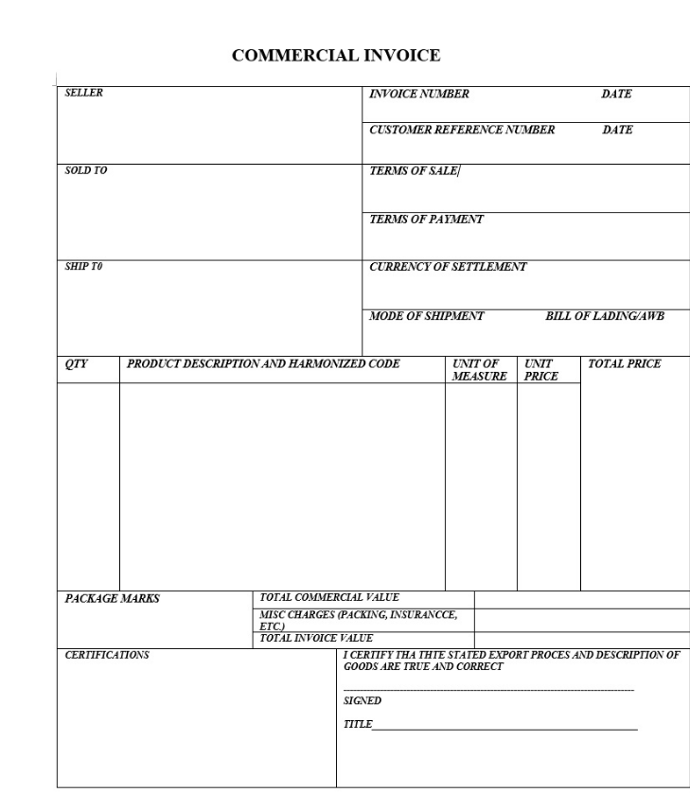
Commercial Invoice Requirements
Must be in English
Manufacturer or supplier name & address
Consignee name & address
Ingram Micro PO & Reference No.
Qty Shipped
Vendor Part No. / Ingram SKU
Detailed description of goods
Harmonized Tariff Schedule (HTS/HS codes)
Country of origin
Incoterm
Purchase Price/Value in USD
Sample Shipments -indicate “SAMPLE SHIPMENTS – Value for Customs Purposes Only”

Slide 35
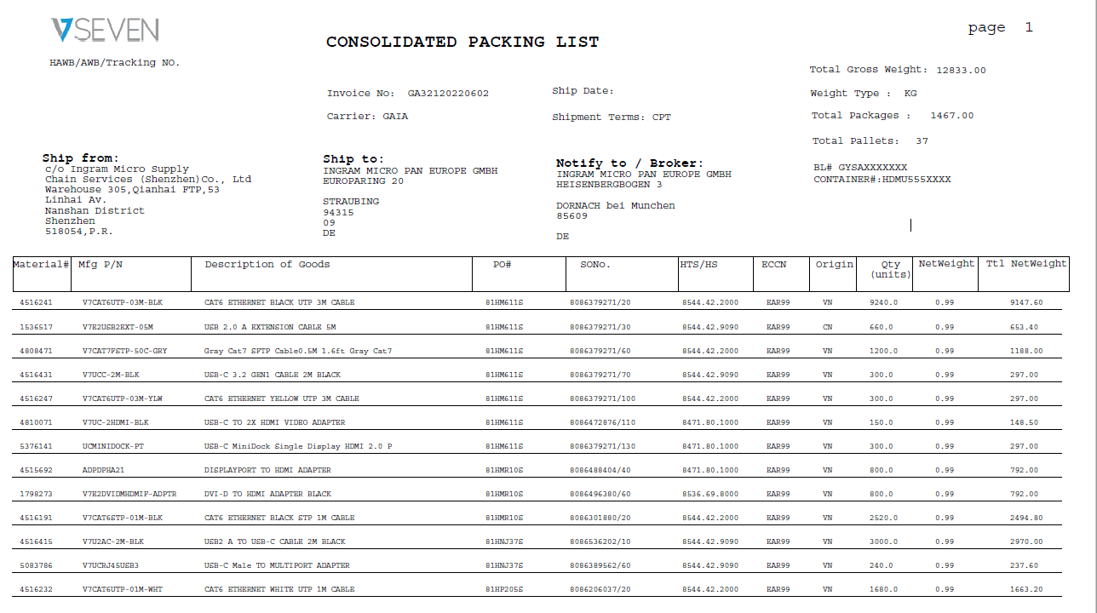
Packing Slip Requirements
Required information for each packing slip:
One packing list per purchase order or per shipment.
Purchase order number
Container number (if known)
Shipper reference number
Pieces and weight
Required Information for Each Line Item
Product description
V7 Part No/Model No.
Number of units
Number of cartons
Number of pallets
And indicate “FLOOR LOAD” when applicable

Slide 36
Ingram V7 Locations, Contact & Notify Party
Branch # City, State Country | Cust PO REF# | Ship To / Consignee (Same as PO) | Notify Party | Also Notify Party | For China Customs
Straubing Germany | 81XXXXXS | INGRAM MICRO PAN EUROPE GMBH, EUROPARING 20, 94315 STRAUBING, GERMANY ATTENTION: MICHELE HEINEMANN TEL: +49-89-4208-1298 | INGRAM MICRO PAN EUROPE GMBH, EUROPARING 20, 94315 STRAUBING, GERMANY ATTENTION: CUSTOMS DEPT TEL: +49-9421-738265 Email: DESR-Customs-Import@ingrammicro.com | INGRAM MICRO INC, WORLD-WIDE PRIVATE LABEL – V7, 3351 MICHELSON DRIVE, SUITE 100, IRVINE, CA 92612, USA ATTENTION: AMIT V. KHAJANCHI TEL: +1-714-382-1067 | Consignee Company Code German VAT ID: DE113858192 Consignee Contact Michèle Heinemann +49-89-4208-1298
Branch 10 Mira Loma, CA USA | 10XXXXXS | INGRAM MICRO INC., 12510 MICRO DRIVE, MIRA LOMA, CA 91752, USA ATTENTION: RECEIVING TEL: +1 (951) 727-3341 USMR_Scheduling@ingrammicro.com https://usmr.yardcommander.com | TransAmerican 4902 North America Drive Buffalo, NY 14224 Tel: 716-896-7800 ISF Notices: isfta@TACustomslogistics.com Documentation: setup@TACustomslogistics.com | INGRAM MICRO INC, WORLD-WIDE PRIVATE LABEL – V7, 3351 MICHELSON DRIVE, SUITE 100, IRVINE, CA 92612, USA ATTENTION: AMIT V. KHAJANCHI TEL: +1-714-382-1067 | Consignee Company Code US IRS EIN number: 62-1644402 Consignee Contact Amit V Khajanchi +1-714-382-1067
Branch 20 Fort Worth, TX USA | 20XXXXXS | INGRAM MICRO INC., 14500 FAA BLVD, SUITE 300 FORT WORTH, TX 76155 ATTENTION: RECEIVING TEL: +1 (972) 512-2764 USDAInboundSched-1@ingrammicro.com https://usda.yardcommander.com | TransAmerican 4902 North America Drive Buffalo, NY 14224 Tel: 716-896-7800 ISF Notices: isfta@TACustomslogistics.com Documentation: setup@TACustomslogistics.com | INGRAM MICRO INC, WORLD-WIDE PRIVATE LABEL – V7, 3351 MICHELSON DRIVE, SUITE 100, IRVINE, CA 92612, USA ATTENTION: AMIT V. KHAJANCHI TEL: +1-714-382-1067 | Consignee Company Code US IRS EIN number: 62-1644402 Consignee Contact Amit V Khajanchi +1-714-382-1067
Branch 70 Moore, SC USA | 70XXXXXS | INGRAM MICRO INC., 6675 HIGHWAY 221 MOORE, SC 29369 ATTENTION: RECEIVING TEL: TBD usscscheduling@ingrammicro.com https://ussc.yardcommander.com | TransAmerican 4902 North America Drive Buffalo, NY 14224 Tel: 716-896-7800 ISF Notices: isfta@TACustomslogistics.com Documentation: setup@TACustomslogistics.com | INGRAM MICRO INC, WORLD-WIDE PRIVATE LABEL – V7, 3351 MICHELSON DRIVE, SUITE 100, IRVINE, CA 92612, USA ATTENTION: AMIT V. KHAJANCHI TEL: +1-714-382-1067 | Consignee Company Code US IRS EIN number: 62-1644402 Consignee Contact Amit V Khajanchi +1-714-382-1067
Branch 40 Carol Stream, IL USA | 40XXXXXS | INGRAM MICRO INC., 415 E LIES ROAD, CAROL STREAM, IL 60188, USA ATTENTION: RECEIVING TEL: +1 (630) 668-0106 X34245 USCSInboundSched-1@ingrammicro.com https://uscs.yardcommander.com | TransAmerican 4902 North America Drive Buffalo, NY 14224 Tel: 716-896-7800 ISF Notices: isfta@TACustomslogistics.com Documentation: setup@TACustomslogistics.com | INGRAM MICRO INC, WORLD-WIDE PRIVATE LABEL – V7, 3351 MICHELSON DRIVE, SUITE 100, IRVINE, CA 92612, USA ATTENTION: AMIT V. KHAJANCHI TEL: +1-714-382-1067 | Consignee Company Code US IRS EIN number: 62-1644402 Consignee Contact Amit V Khajanchi +1-714-382-1067
Branch 80 Hazle Township, PA USA | 89XXXXXS | INGRAM MICRO INC., 101 COMMERCE DRIVE HAZLE TOWNSHIP, PA 18202, USA ATTENTION: RECEIVING TEL: TBD Ushzinboundscheduling@ingrammicro.com https://ushz.yardcommander.com | TransAmerican 4902 North America Drive Buffalo, NY 14224 Tel: 716-896-7800 ISF Notices: isfta@TACustomslogistics.com Documentation: setup@TACustomslogistics.com | INGRAM MICRO INC, WORLD-WIDE PRIVATE LABEL – V7, 3351 MICHELSON DRIVE, SUITE 100, IRVINE, CA 92612, USA ATTENTION: AMIT V. KHAJANCHI TEL: +1-714-382-1067 | Consignee Company Code US IRS EIN number: 62-1644402 Consignee Contact Amit V Khajanchi +1-714-382-1067
Branch 17 Miami, FL | 17XXXXXS | INGRAM MICRO INC., 2000 NW 84TH AVE Miami, FL 33122 +1-305-593-5900 MiamiBusOps@ingrammicro.com | TransAmerican 4902 North America Drive Buffalo, NY 14224 Tel: 716-896-7800 ISF Notices: isfta@TACustomslogistics.com Documentation: setup@TACustomslogistics.com | INGRAM MICRO INC, WORLD-WIDE PRIVATE LABEL – V7, 3351 MICHELSON DRIVE, SUITE 100, IRVINE, CA 92612, USA ATTENTION: AMIT V. KHAJANCHI TEL: +1-714-382-1067 | Consignee Company Code US IRS EIN number: 62-1644402 Consignee Contact Amit V Khajanchi +1-714-382-1067

Slide 37

Ingram Micro as Importer of Record (for US ONLY)
C-TPAT
  For Ingram Micro to act as the Importer of Record, vendor must be vetted under
  Customs & Trade Partnerships Against Terrorism( C-TPAT)
  C-TPAT is a US Customs program designed to help secure the supply chains leading into the U.S.
  Participants include importers, carriers, consolidators, customs brokers & manufacturers
  Annual certification is mandatory
  *If you are unsure if your organization has been vetted, pls consult with the V7 Supply Chain team*

Slide 38


Questions???
CONTACT US VIA EMAIL
V7 Supply Chain Team
V7Supplychain@IngramMicro.com
Amit Khajanchi – Head of Operations &Compliance
Amit. Khajanchi@IngramMicro.com

